Slide 1


AERIAL CROP MONITORING AND YIELD PREDICTION USING AERIAL IMAGERY
SIMATS ENGINEERING
SAVEETHA INSTITUTE OF MEDICAL AND TECHNICAL SCIENCES
Capstone Project Review-1
ITA0506_Computer Vison
PRESENTED BY:
K. Manoj Kumar(192472395)
P.V D NAGENDRA REDDY(192472399)
pranay km(192321055)
Lenin K(192321050)
Program Director:
Dr.Sasi Rekha,Prof/CSE
Guided By:
Mrs.R C Jeni Gracia, AP / CSE

Slide 2
Agenda
Introduction
Literature Review
Problem Statement
Objectives
System Architecture – Overall Design
Introduction Project Modules
Future Enhancement
Conclusion

Slide 3
Introduction
Agriculture requires continuous monitoring to maintain healthy crop growth.
Traditional crop inspection is manual, time-consuming and difficult for large agricultural fields.
Crop stress and diseases may develop between manual inspections.
Aerial images provide a large-area view of crop conditions.
Computer Vision and AI can automatically analyze crop images.
Our project focuses on daily monitoring of crop health and early identification of abnormal changes.

Slide 4
Problem Statement
Farmers cannot manually monitor every part of a large field every day.
Early crop stress and disease symptoms may be missed.
A single aerial image gives only a snapshot of crop condition.
There is no continuous comparison between today's crop condition and previous days.
Farmers need an automated system that can identify health deterioration and generate alerts.
Therefore, we propose a daily live crop-health monitoring system using aerial imagery, computer vision and AI.

Slide 5
Existing System vs Proposed System
Existing System | Proposed System
Manual inspection | Automated monitoring
Occasional observation | Daily monitoring
Large human effort | Computer Vision based
Difficult to monitor large fields | Large-area aerial monitoring
Disease detected after visible symptoms | Early stress/disease indication
No continuous health history | Day-wise health history
No automatic alerts | Automated alerts
Limited visualization | Live dashboard

Slide 6
Objectives
Acquire high-quality aerial images of agricultural fields.
Detect crop health issues and diseases using image processing and deep learning.
Predict crop yield using machine learning algorithms.
Provide an interactive dashboard for visualization, monitoring, and decision support.
Improve agricultural productivity through timely and data-driven insights.

Slide 7
Literature Review
S.No | Author & Year | Title | Technologies Used | Limitations
1 | Li Zhang et al., 2025 | Deep Learning-Based Crop Disease Detection Using UAV Aerial Images | UAV Imagery, CNN, Deep Learning, OpenCV | Performance decreases under varying lighting conditions.
2 | Maria Gonzalez et al., 2025 | AI-Driven Crop Health Monitoring Using Multispectral Aerial Imagery | Multispectral Imaging, AI, TensorFlow, GIS | Requires expensive multispectral cameras.
3 | Rahul Sharma et al., 2026 | Machine Learning Framework for Crop Yield Prediction Using Aerial Images | Machine Learning, Random Forest, Python, Drone Imaging | Prediction accuracy depends on the quality of training data.
4 | Ahmed Hassan et al., 2025 | Precision Agriculture Using Deep Learning and Remote Sensing | Deep Learning, Remote Sensing, Image Processing | Limited validation across different crop varieties.
5 | Emily Johnson et al., 2026 | Intelligent Crop Monitoring and Yield Estimation Using Computer Vision | Computer Vision, CNN, OpenCV, TensorFlow | High computational requirements for real-time processing.
6 | S. Ramesh et al., 2025 | Crop Health Assessment Using Aerial Image Analysis and Deep Learning | Python, Deep Learning, Image Segmentation | Reduced accuracy in cloudy weather conditions.
7 | Yuki Tanaka et al., 2026 | Smart Agriculture: Aerial Image-Based Crop Monitoring with AI Analytics | Artificial Intelligence, GIS, CNN, IoT | Large datasets increase processing time.
8 | Priya Nair et al., 2025 | Automated Crop Yield Prediction Using Deep Neural Networks and Aerial Imagery | Deep Neural Networks, Python, TensorFlow, Image Processing | Limited generalization to diverse geographical regions.

Slide 8
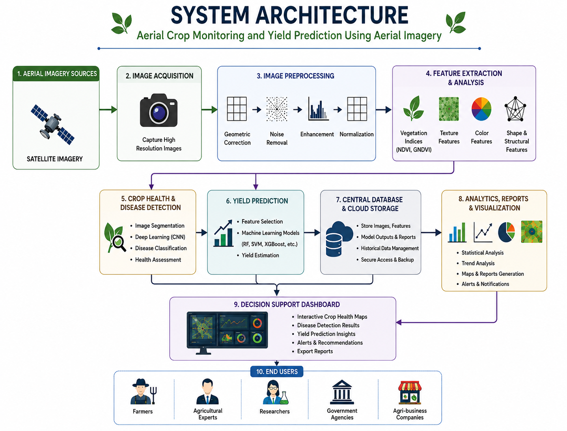

Slide 9
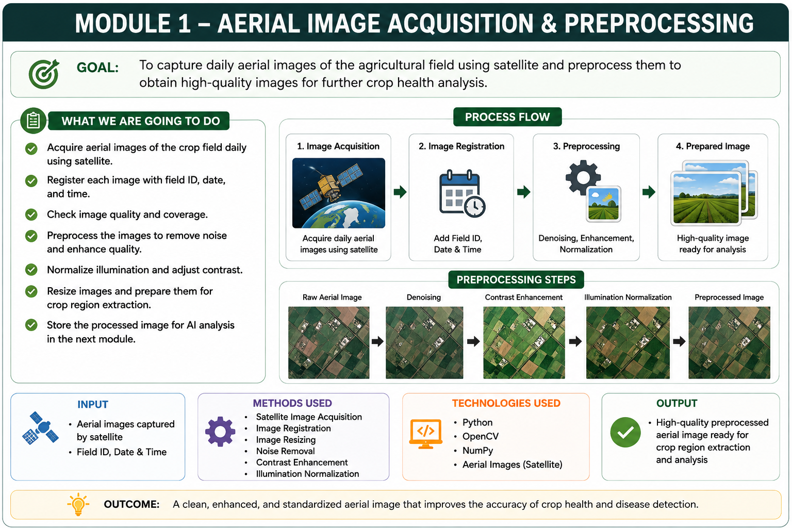

Slide 10
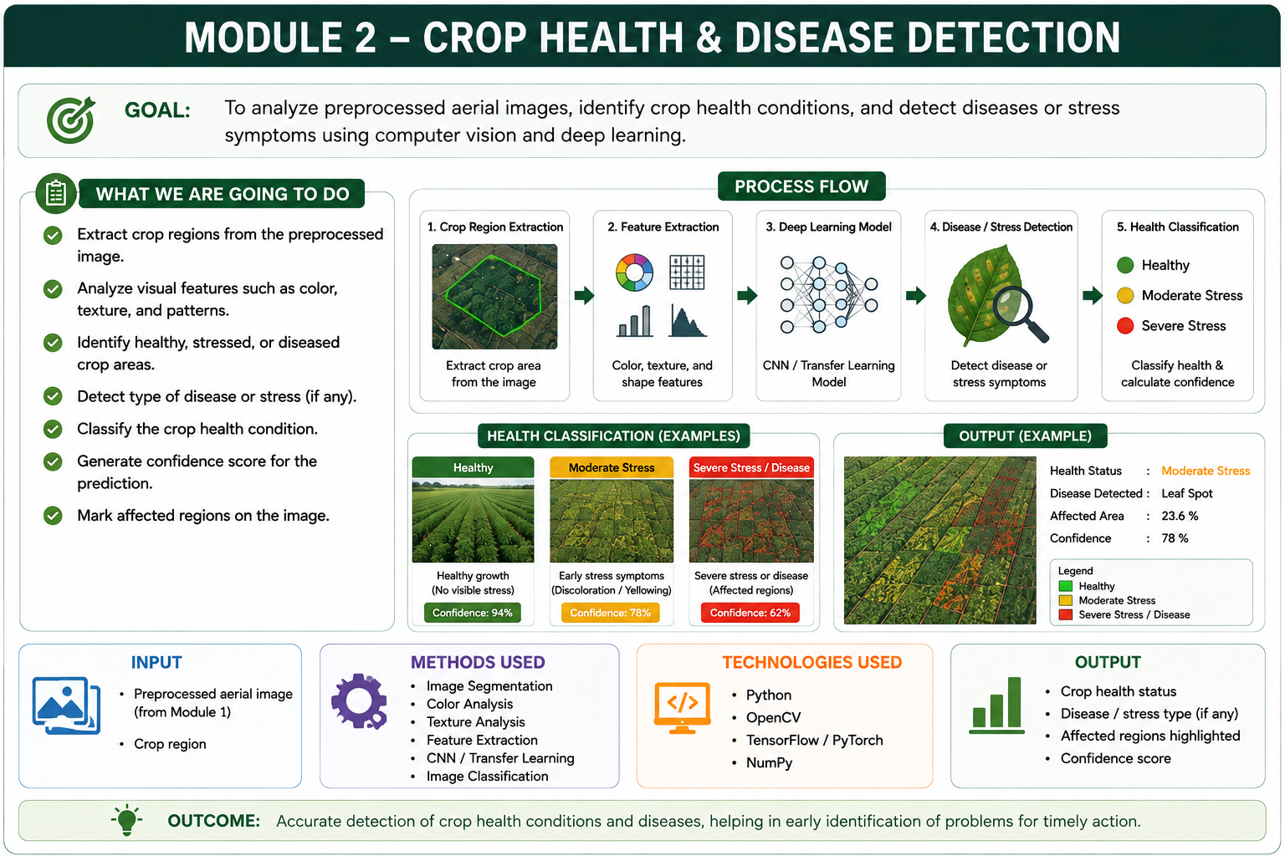

Slide 11
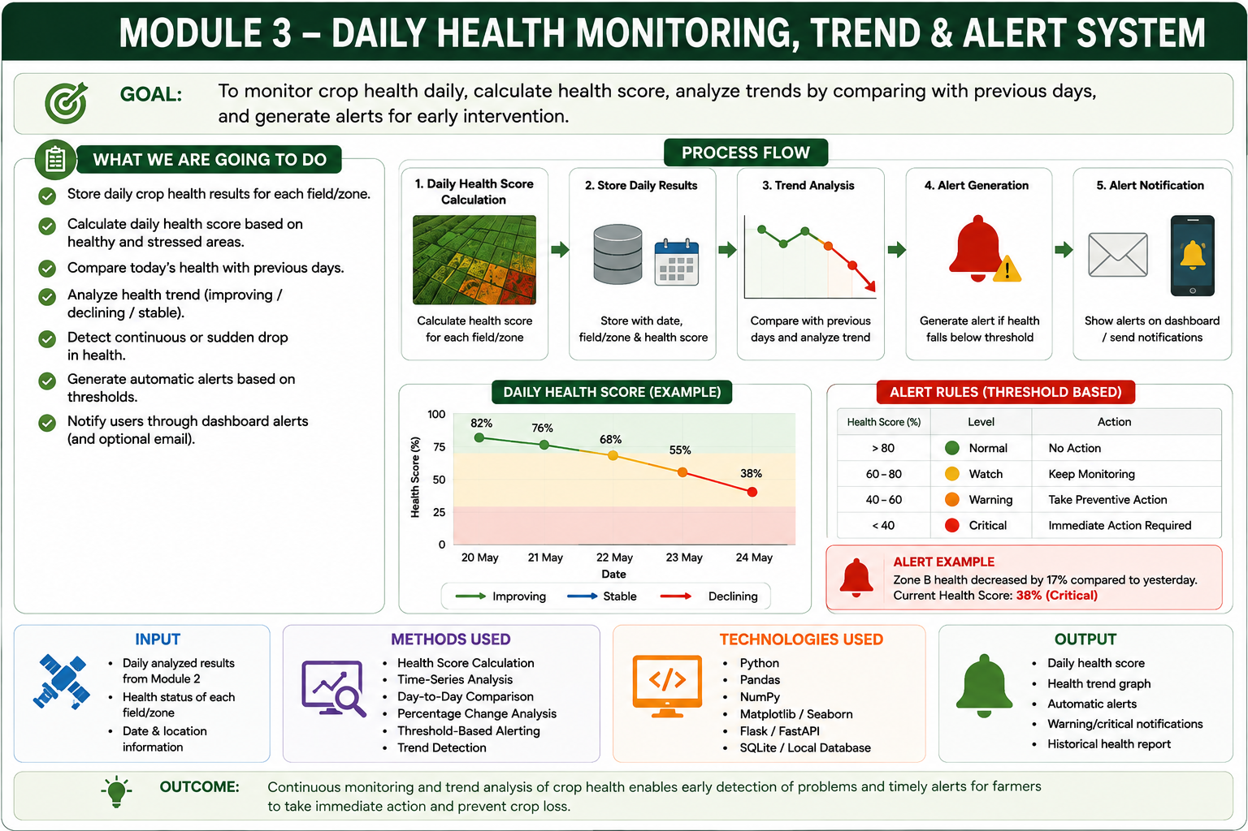

Slide 12
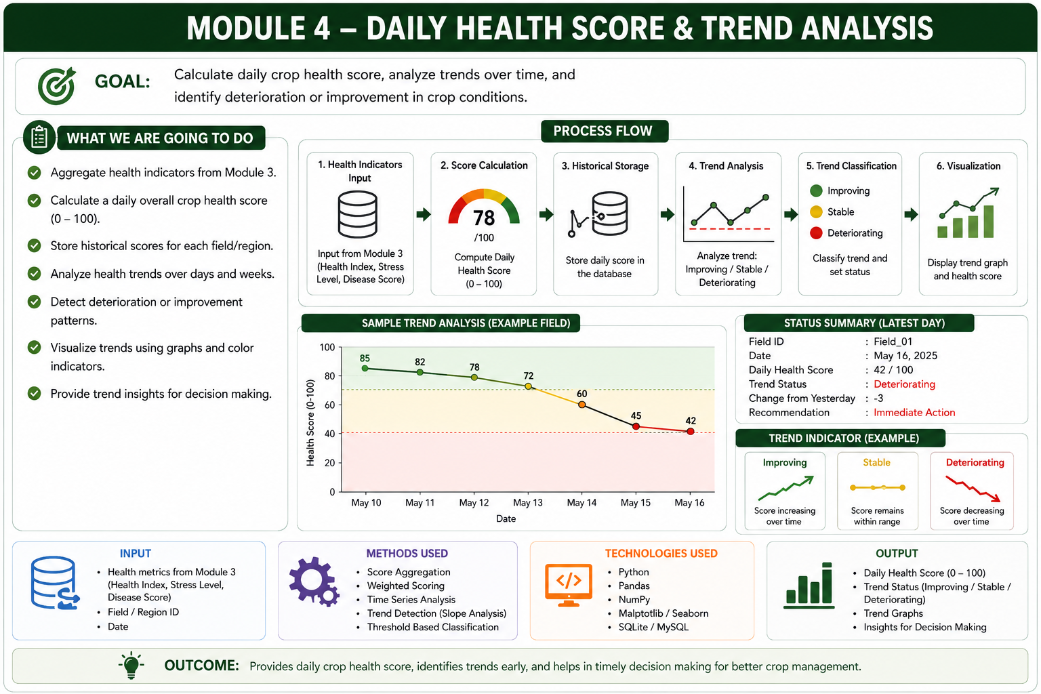

Slide 13

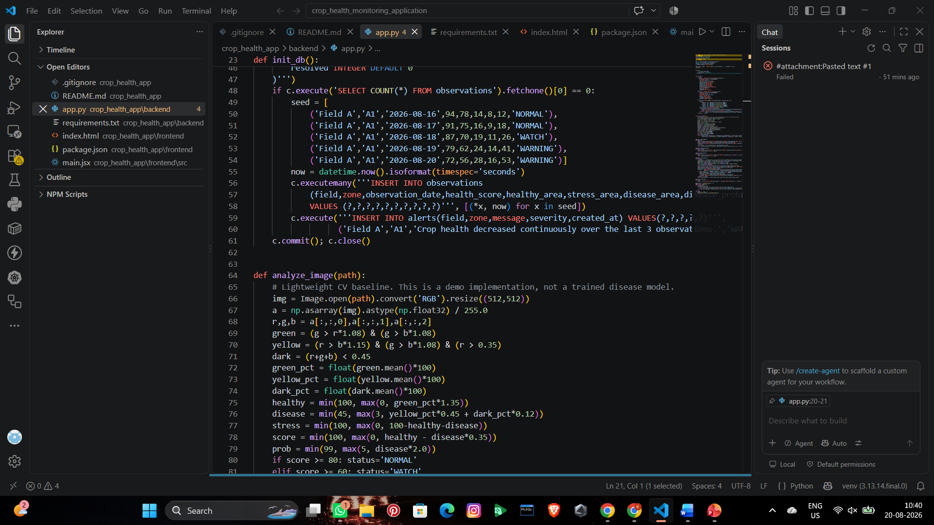
Implementation

Slide 14
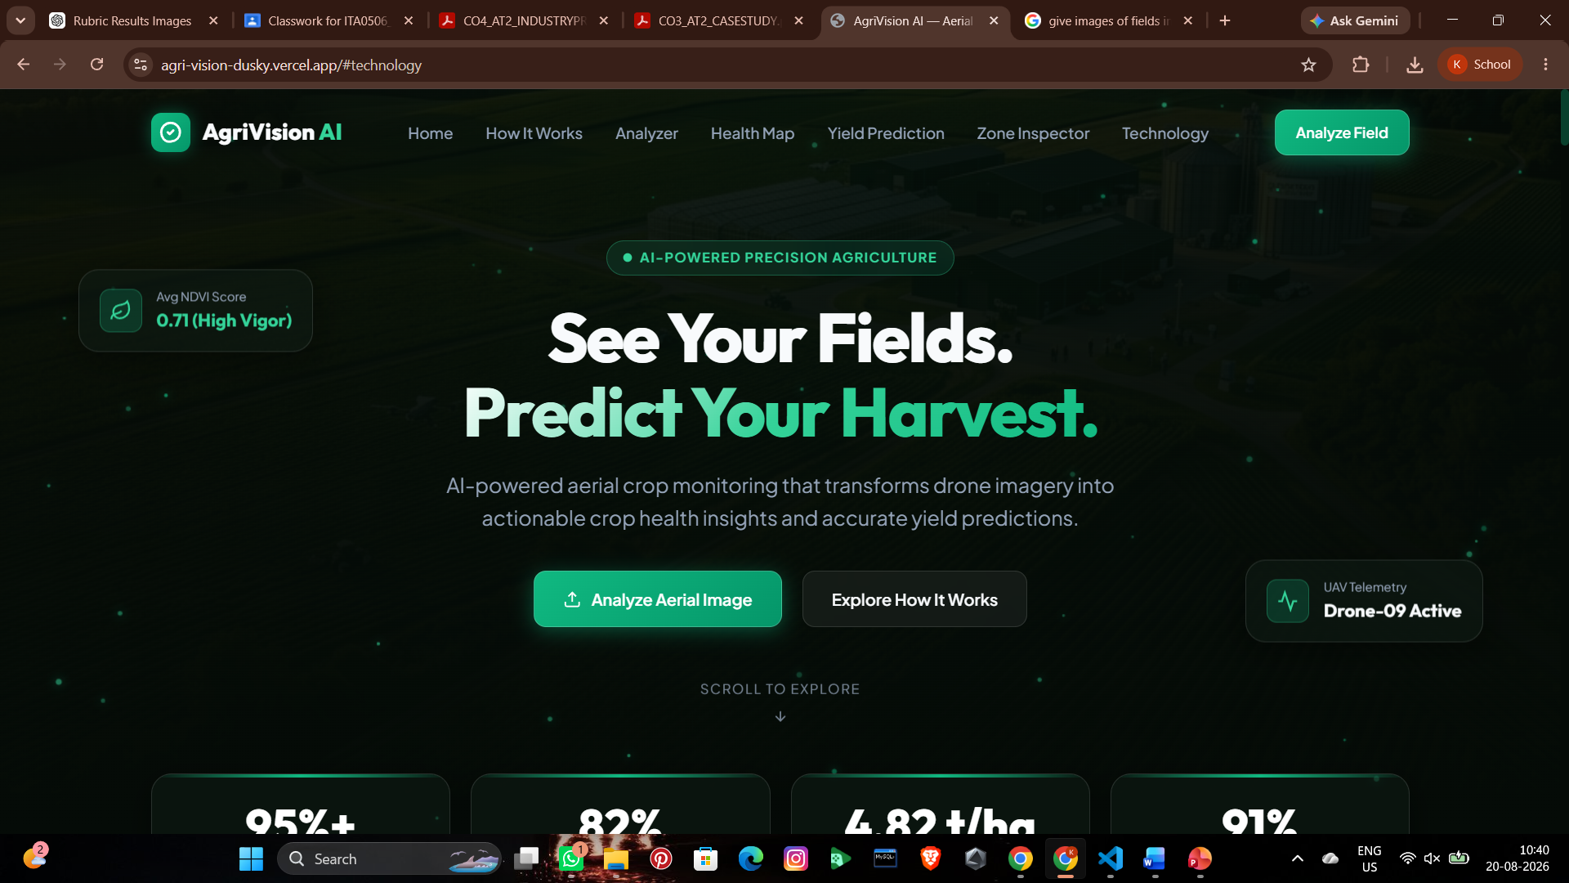
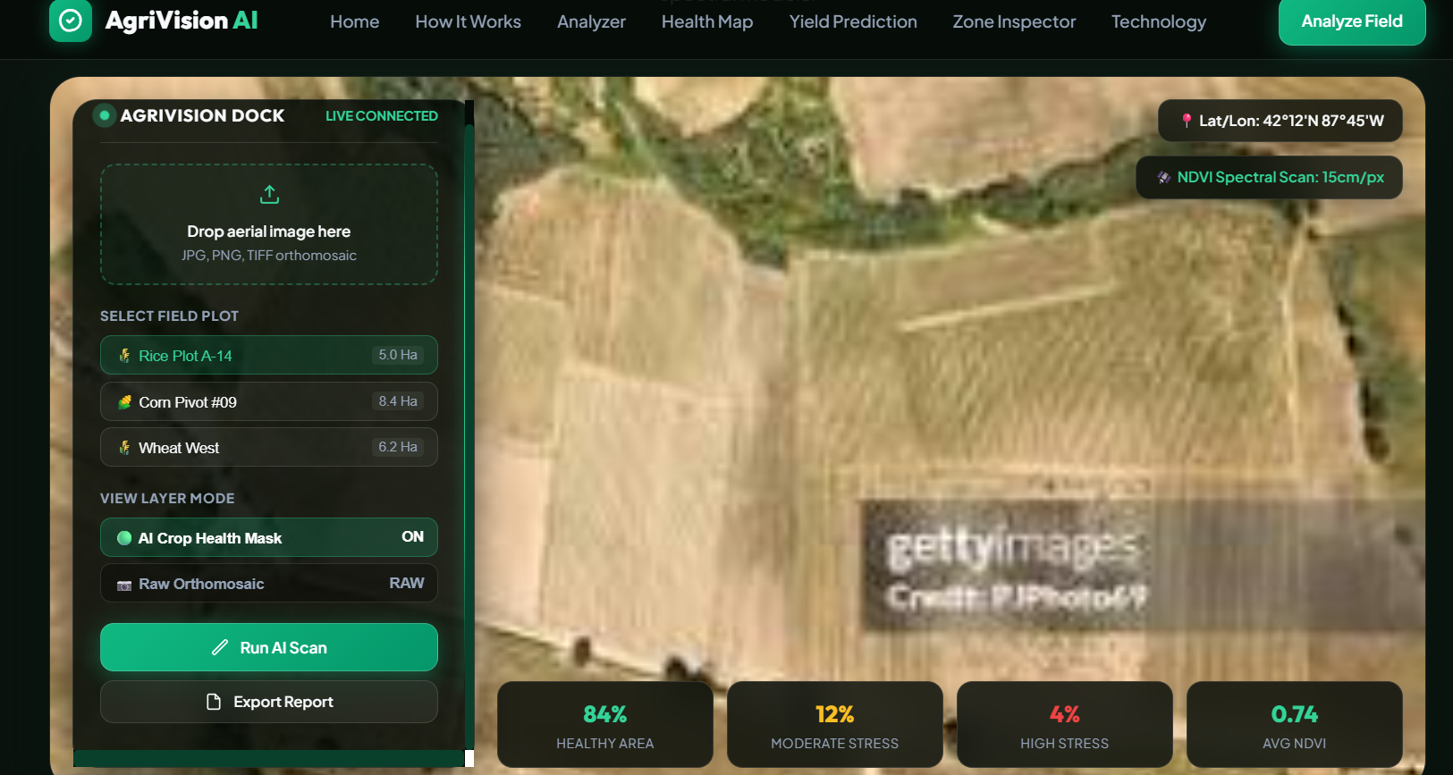
OUTPUT

Slide 15
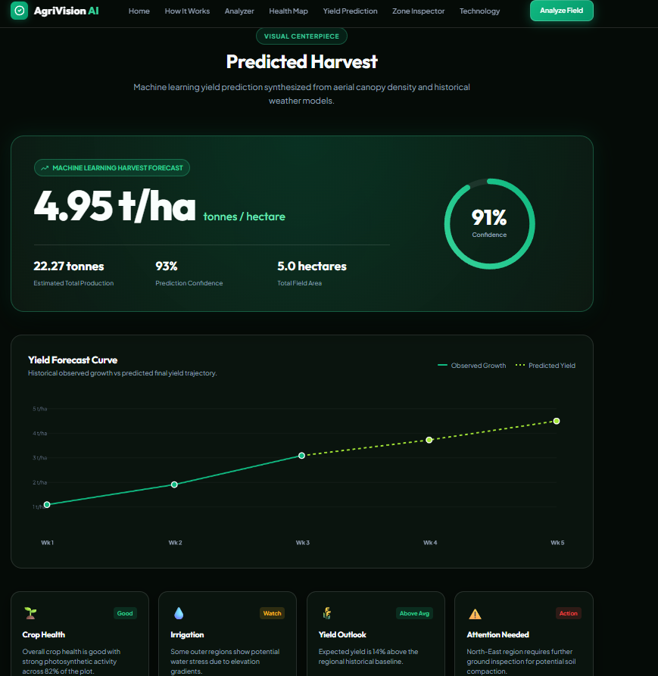
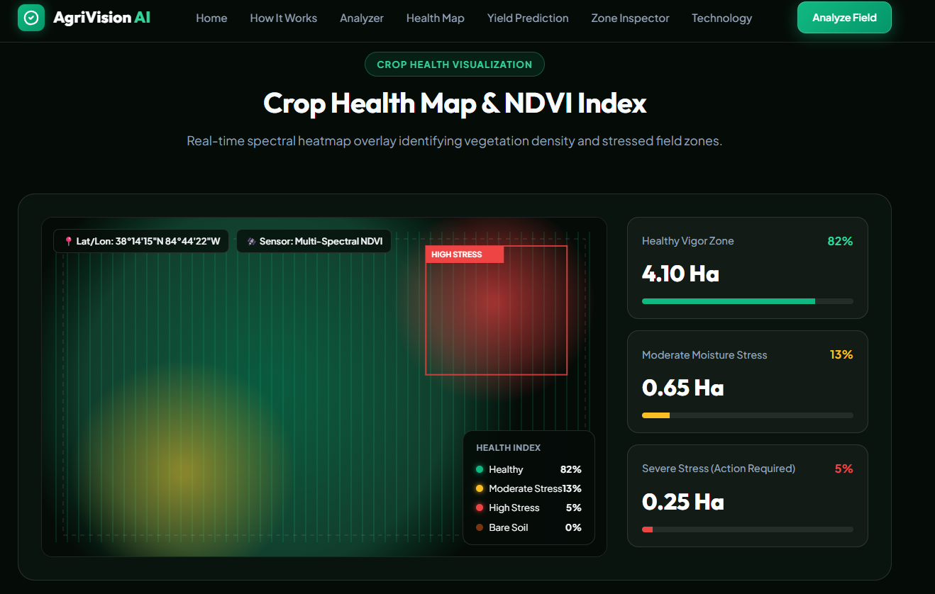

Slide 16
Conclusion
The proposed system combines aerial imagery, computer vision, and artificial intelligence to improve precision agriculture.
It enables efficient crop health monitoring, disease detection, and accurate yield prediction.
Interactive visualization and decision-support tools help farmers make informed agricultural decisions.
The system reduces manual effort while increasing productivity and sustainability.
Overall, the project contributes to smarter, technology-driven farming and supports sustainable agricultural development.

Slide 17
Future Enhancements
Integrate multispectral and hyperspectral imagery for improved analysis.
Incorporate real-time IoT sensor data (soil moisture, temperature, humidity).
Develop a mobile application for farmers to access reports and alerts.
Implement real-time monitoring using live aerial image streams.
Expand the system to support multiple crop types and different geographical regions.
Integrate weather forecasting to improve yield prediction accuracy.

Slide 18


